Slide 1
Gas leakage detection system with auto off
LPG gas regulator using arduino
PRESENTED BY :
KODISMITH R (22AI024)
NARESH S (22AI028)
NAVEEN PRASATH A (22AI030)
GUIDED BY :
DR.K.LALITHA
TEAM NO : 14
COURSE TITLE : INTERNET OF THINGS & COURSE CODE : 22AIC14
Notes:
1.7.2013
1
‹#›

Slide 2
Abstract
This project presents a gas leakage detection system that
automatically shuts off the LPG gas regulator in case of a gas leak.
The system utilizes an
Arduino board,
gas sensor,
and solenoid valve
to detect and respond to gas leaks,
ensuring user safety and preventing accidents.
Notes:
1.7.2013
2
‹#›

Slide 3
Objectives:
- Detect gas leaks in real-time
- Automatically shut off the LPG gas regulator in case of a gas leak
- Provide a warning system for users
- Improve safety and prevent accidents
Notes:
1.7.2013
3
‹#›

Slide 4
Components Required:
- Arduino Board (e.g., Arduino Uno)
- Gas Sensor (e.g., MQ-6 or MQ-5 MQ-2)
- LPG Gas Regulator
- Servo motor
-Buzzer
-Exhaust fan
- Power Supply
- Breadboard and Jumper Wires
- LCD Display (optional)
Notes:
1.7.2013
4
‹#›

Slide 5
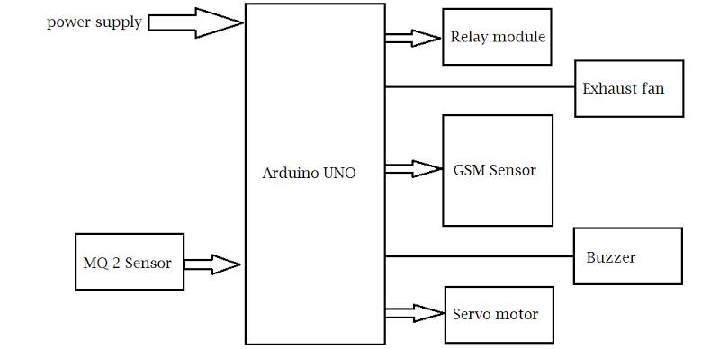
Flow Diagram:
Notes:
1.7.2013
5
‹#›

Slide 6
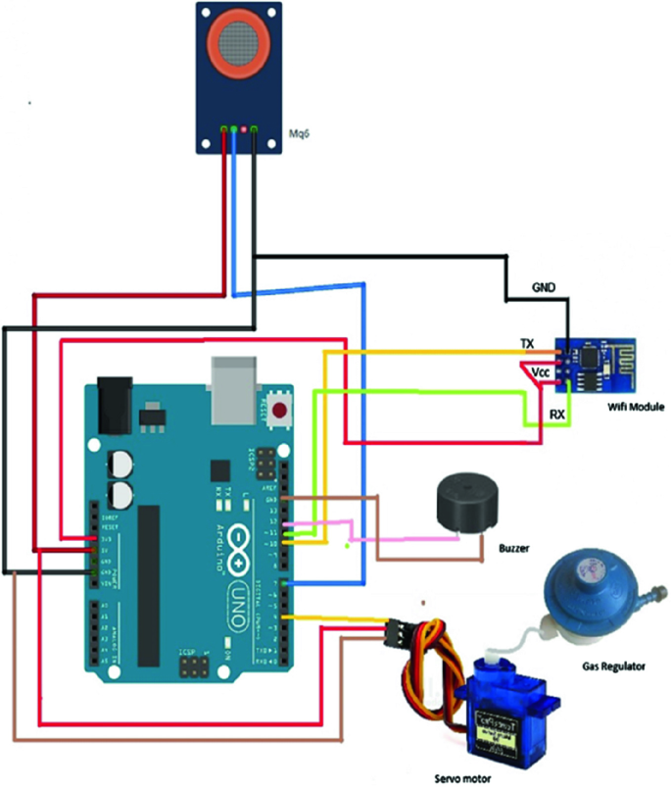
Design:
Notes:
1.7.2013
6
‹#›

Slide 7
Implementation:
(Hardware or software)
- Hardware:
- Assemble the circuit on a breadboard or PCB
- Connect the gas sensor, solenoid valve, and power supply
- Ensure proper connections and testing
- Software:
- Write the Arduino code to read gas concentration values and control the servo motor
- Set the threshold value for gas concentration
- Implement the warning system (if using LCD display)
- Test and debug the code
Notes:
1.7.2013
7
‹#›

Slide 8
Thank you

